Slide 1
Ethnicity
Presented By:
Nimra Amer (21L-5609)
Muhammad Hamza (21L-5636)
Muhmmad Hassan Khalid (21L-5692)
Muhammad Ahmad (21L-5617)

Slide 2
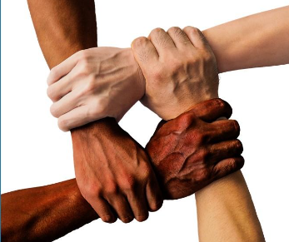
Race
Race is a social construct shaped by biological traits and societal perceptions of trait significance.
People classify each other based on physical traits like skin color, facial features, hair texture, and body shape
Human ancestors developed racial diversity due to living in diverse geographic regions
A "race" is defined by society when certain physical traits like skin color or eye shape are deemed significant.

Slide 3
Caucasoid
People with lighter skin
Negroid
People with darker skin and coarse hair
Racial Types
Mongoloid
People with yellow or brown skin
Australoid
People with darker skin and curly hair

Slide 4
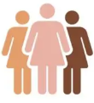
Ethnicity
Ethnicity is a shared cultural heritage.
People define themselves—or others—as members of an ethnic category based on common ancestry, language, or religion that gives them a distinctive social identity.
Race is constructed from biological traits and ethnicity is constructed from cultural traits

Slide 5
Race
A socially constructed category of people sharing biologically transmitted traits considered important by a society.
Ethnicity
A shared cultural heritage
Ethnic identity is self-defined and extends beyond physical traits, rooted in shared customs, values, and beliefs.

Slide 6
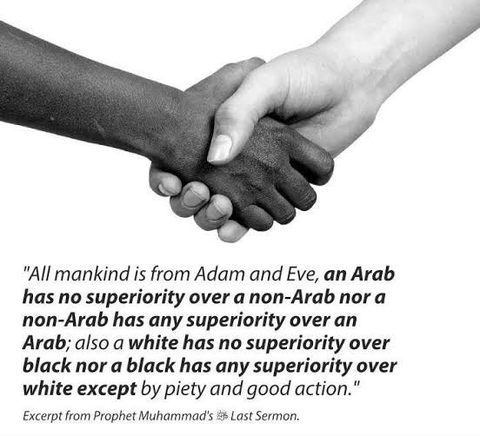

Slide 7
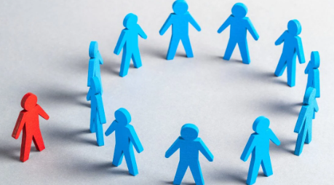
Minorites
A minority group is defined by societal distinctions based on physical or cultural differences, often leading to segregation and subordination.
Job success rarely allows individuals to escape their minority standing.
Race or ethnicity often serves as a master status that overshadows personal accomplishments
Minorities usually make up a small proportion of a society’s population, but this is not always the case.

Slide 8
Characteristics of Minority
Distinctive Identity
Subordination
Placing groups in a position of lower status , power or authority compared to the majority groups
which may be based on physical or cultural traits

Slide 9
Prejudice
Prejudice is the product of ignorance that hides behind barriers of tradition
Prejudice is a rigid and unfair generalization about an entire category of people.
Prejudice is unfair because all people in some category are described as the same, based on little or no direct evidence.
Prejudices are prejudgments that can be either positive or negative.
Prejudice often takes the form of a stereotype, a simplified description applied to every person in some category

Slide 10
Prejudice
Rigid and unfair generalization about an entire category of people
A simplified description applied to every person in some category.
Stereotype

Slide 11
Measuring Prejudice
Social Distance Scale
Most Negative Prejudice:
A particular set of people should be barred from the country
Most social Acceptance:
Acceptance of a specific group of people in a society

Slide 12
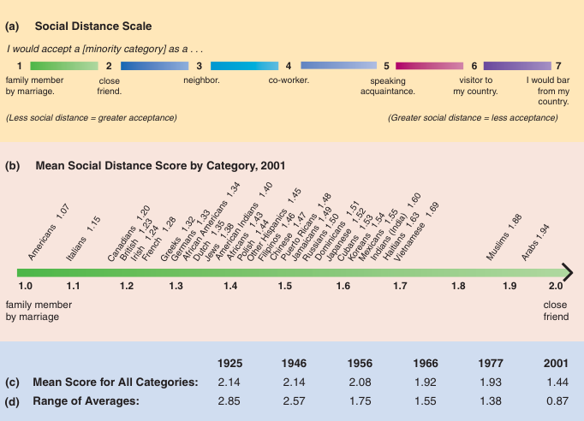

Slide 13
Theories of Prejudice
01
02
03
04
Scapegoat Theory
Authoritarian
Personality Theory
Culture Theory
Conflict Theory

Slide 14
Theories of Prejudice
Scapegoat
Theory
Prejudice springs from frustration among people who are themselves disadvantaged. A scapegoat is a person or category of people, typically with little power, whom people unfairly blame for their troubles
Authoritarian Personality Theory
The idea that some people have a strong tendency to be prejudiced and intolerant toward others.

Slide 15
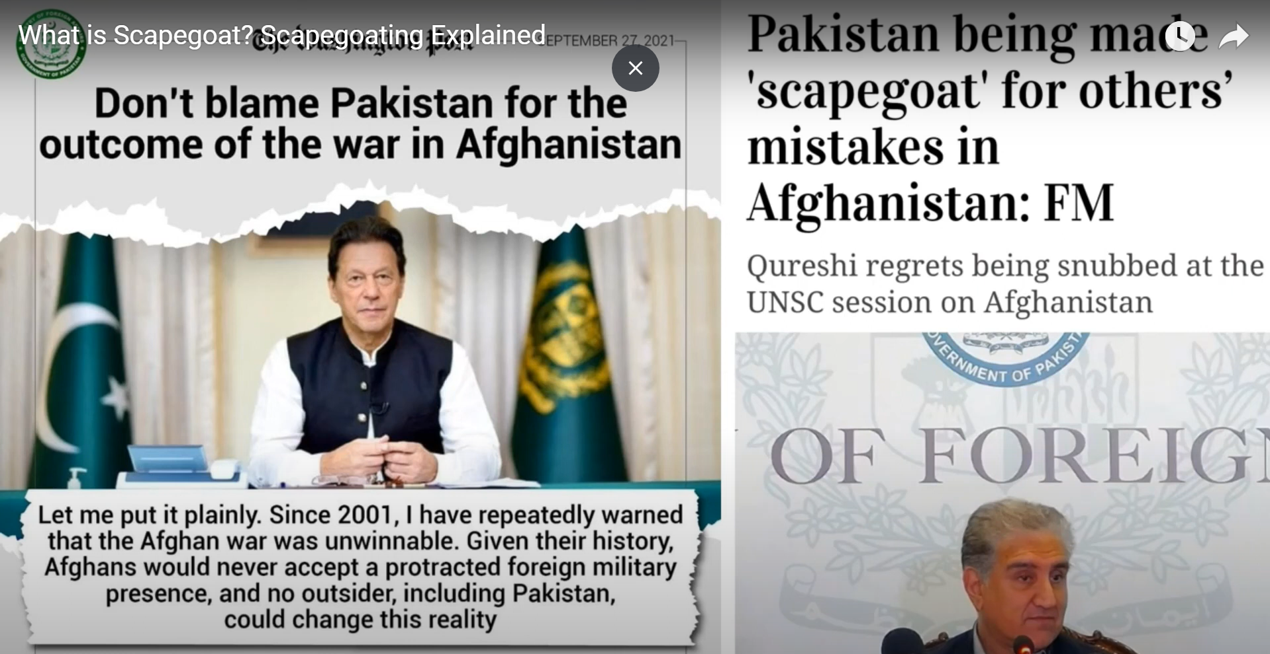

Slide 16
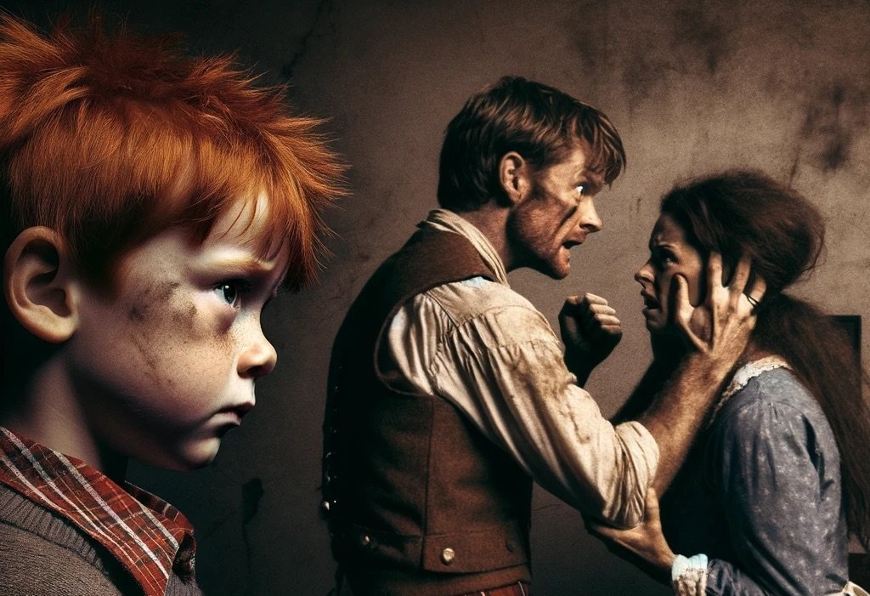
Authoritarian Personality Theory
Authoritarian Personality Theory

Slide 17
Theories of Prejudice
Culture
Theory
It sees prejudice as part of our cultural upbringing, suggesting that it's learned through societal norms and values. This explains why biases can exist in everyone, even in minorities towards other groups
Conflict Theory
It views prejudice as a means for powerful groups to maintain control It also indicates that some minority groups might use race consciousness to seek special treatment, potentially leading to backlash from others..

Slide 18
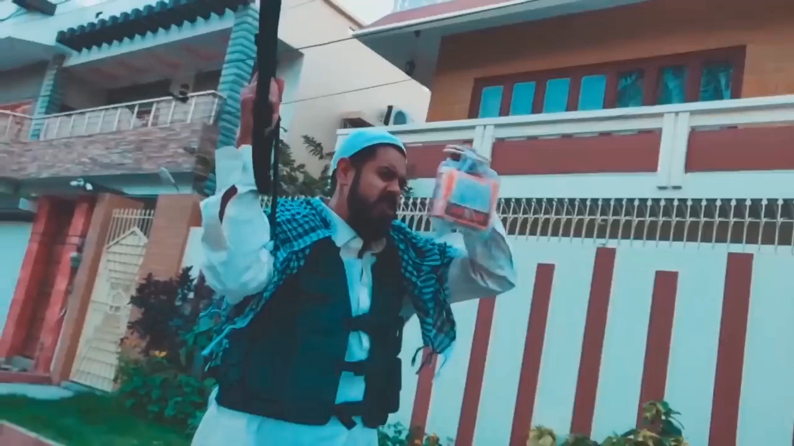

Slide 19
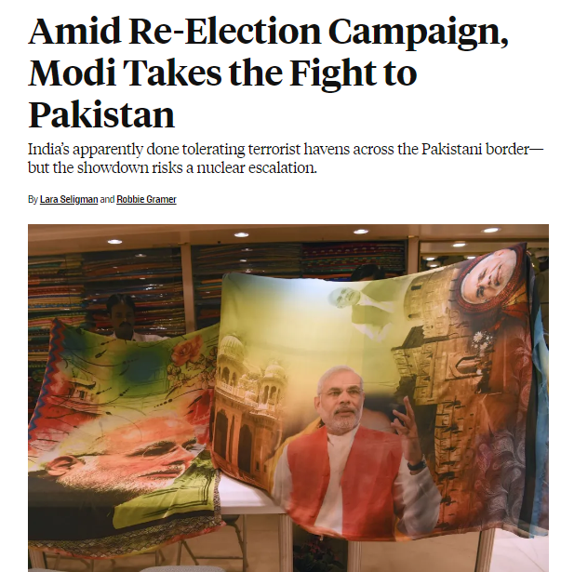

Slide 20
Discrimination
Unequal treatment of various categories of people
biseness in institutional places
Institutional Prejudice and Discrimination

Slide 21
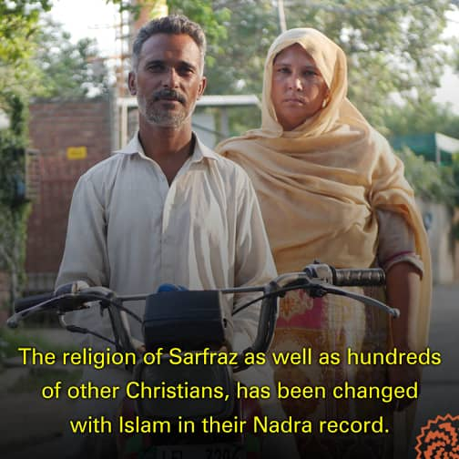
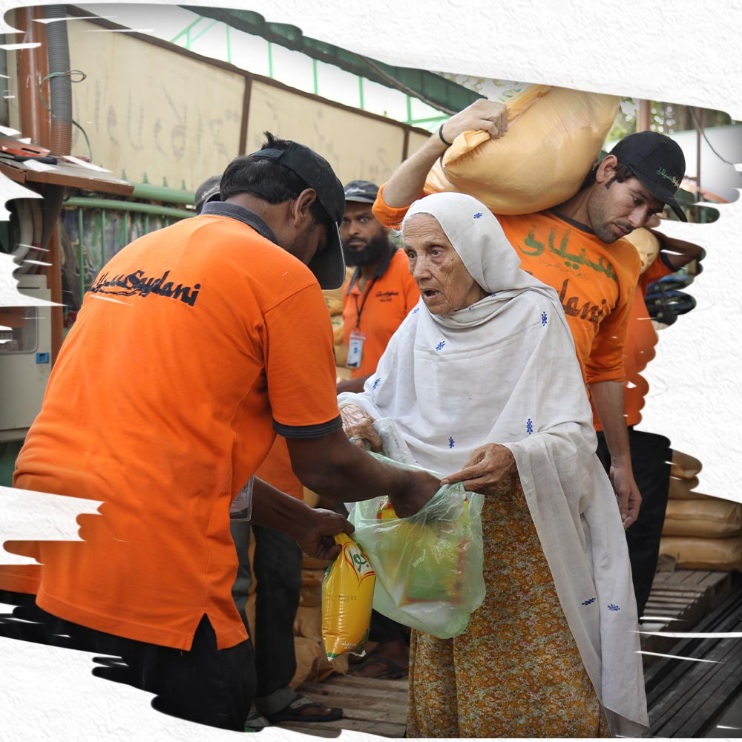
“It’s not for Hindus”

Slide 22
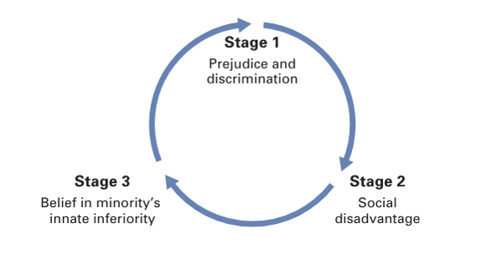
Prejudice and Discrimination: The Vicious Cycle

Slide 23
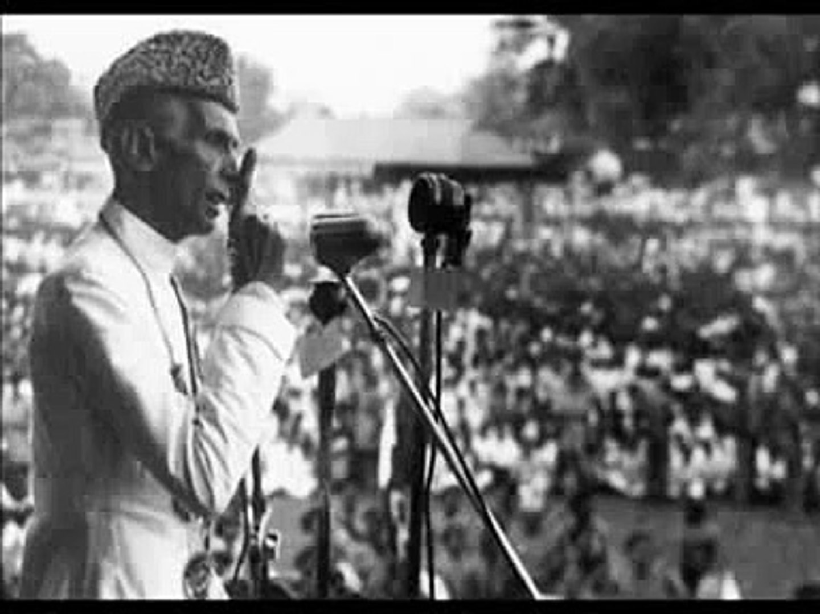
"You may belong to any religion, caste, or creed—that has nothing to do with the business of the state." - Quaid-e-Azam Muhammad Ali Jinnah

Slide 24
Patterns of Interaction
Pluralism
Assimilation
Segregation
Genocide
The process by which minorities gradually adopt patterns of the dominant culture.
The physical and social separation of categories of people
The systematic killing of one category of people by another
A state in which people of all races and ethnicities are distinct but have equal social standing.

Slide 25
Conclusion
يَا أَيُّهَا النَّاسُ إِنَّا خَلَقْنَاكُم مِّن ذَكَرٍ وَأُنثَىٰ وَجَعَلْنَاكُمْ شُعُوبًا وَقَبَائِلَ لِتَعَارَفُوا ۚ إِنَّ أَكْرَمَكُمْ عِندَ اللَّهِ أَتْقَاكُمْ ۚ إِنَّ اللَّهَ عَلِيمٌ خَبِيرٌ

Slide 26
Thank You!

